Slide 1
End-to-End Chinese News Analytics: From Web Crawling to Co-occurrence, PMI, and Document Similarity
mc56730 — WU QIWEI
mc56733 — GUO XIAOYU
mc56565 — KANG PENGFEI
mc56677 — QIU WENLE
mc56688 — TIAN JISHENG
GroupBT

Slide 2

CONTENTS
01：Overview
02：Motivation & Team Background
03：Data
04：Environment & Installation
05：How to Reproduce
06：Data Engineering, Cleaning, and Management
07：Data Analysis: Learning, Analytics, Visualization
08：Visualization & Interpretation
09：Results & Insights
10：Conclusion & Reflection
11：References
12：Acknowledgements

Slide 3
Overview
01

Slide 4
Overview
What does repository implement
This repository implements a programming-first, end-to-end data science workflow on contemporary Chinese news. We collect our own datasets from ChinaNews and Sina News via web crawling, perform rigorous data cleaning and management, and conduct interpretable analytics including adjacent character co-occurrence probabilities, pointwise mutual information (PMI), word frequency analysis, and document-level mutual information. The pipeline emphasizes reproducibility, code-driven analysis, and visual storytelling through heatmaps, histograms, network graphs, and word clouds

Slide 5

Key contributions Self-collected datasets from two major Chinese news sources (ChinaNews and Sina News) Clean, reproducible pipeline for co-occurrence and PMI analysis at the character level Word-level insights (frequency distributions, word clouds) and article complexity metrics Document-level mutual information and comprehensive visualizations for comparative analysis

Slide 6
Motivation & Team Background
02

Slide 7

Motivation
What are public news streams
Public news streams are a widely available, continuously updated signal about markets, policy, technology, and social narratives. They offer rich linguistic patterns—collocations, stylistic markers, and topical signifiers—that can be analyzed programmatically without relying on opaque models

Slide 8

Motivation
Compare news outlets lexically
How to build a fully reproducible, interpretable, and code-centric pipeline that transforms raw web news into actionable analytics—discovering strong adjacent collocations (via co-occurrence probabilities and PMI), surfacing topical markers (via word frequency), and quantifying article similarity (via document-level mutual information). The project answers: “What lexical structures and stylistic tendencies characterize different news outlets, and how can we compare them in a transparent, programming-first way?”

Slide 9
Motivation
01
Interpretability and transparency are critical in data science—especially for text analytics used in decision-making and monitoring. Our approach favors clear, auditable metrics over black-box accuracy
02
Reproducibility: By focusing on end-to-end programming (web crawling → cleaning → engineered analytics → visualizations), we demonstrate a practical template that others can extend or audit
03
Practical relevance: Collocational strength and document similarity inform downstream tasks (keyword expansion, topic discovery, content curation), and support comparative media studies (e.g., economic vs. national focus across outlets)

Slide 10





Team Background：Team Members
mc56730 — WU QIWEI
mc56733 — GUO XIAOYU
mc56565 — KANG PENGFEI
mc56677 — QIU WENLE
mc56688 — TIAN JISHENG

Slide 11


Team Background：Strengths and experience
Data engineering proficiency
[TIAN JISHENG and WU QIWEI] Data engineering & cleaning: Proficiency in pandas/numpy, regex-based normalization, Chinese text filtering, and building reusable pipelines with explicit inputs/outputs
Web scraping experience
[QIU WENLE and KANG PENGFEI] Web scraping & data acquisition: Experience with Selenium (headless Chrome), requests, BeautifulSoup, and handling dynamic page structures, delays, and parsing fallbacks

Slide 12
Team Background：Strengths and experience
03
Chinese NLP preprocessing steps
[GUO XIAOYU、TIAN JISHENG and KANG PENGFEI] Chinese NLP preprocessing: Familiarity with jieba tokenization, stop-word handling, and Chinese character-level analysis for co-occurrence and PMI
04
Visualization communication expertise
[WU QIWEI、QIU WENLE and GUO XIAOYU] Visualization & communication: Expertise in matplotlib/seaborn/networkx/wordcloud, visual storytelling, figure annotation, and report structuring

Slide 13

Team Background：Influence on topic choice
What approach prioritized
The team’s skill set naturally aligns with a programming-first, interpretable approach. Rather than optimizing complex models, we prioritized robust pipelines, transparency, and reproducibility
How domain familiarity guide dataset selection
Domain familiarity with Chinese media (business/tech/governance reporting) guided dataset selection (ChinaNews vs. Sina News) and the focus on contrasts between outlets

Slide 14


Team Background：Supporting domain knowledge
What informed stop-word design
Awareness of journalistic style conventions and common formal expressions in Chinese news informed stop-word design, collocation expectations, and interpretation of high-PMI pairs
What shaped similarity analysis
Basic statistics and information theory (PMI, KL/MI) shaped metric choices and the design of document-level similarity analysis

Slide 15
Data
03

Slide 16

Sources and scale
ChinaNews: 10 scroll pages crawled (news1.html to news10.html); titles and article content collected into data/chinanews.csv (965 articles)
Sina News: 20 roll pages crawled; titles and article content collected into data/xinlangnews.csv (975 articles)

Slide 17

Collection methodology 1.Dynamic pages 2.Content extraction 3.Cleaning

Slide 18

Publicly accessible content collected strictly for academic coursework. Respectful scraping: randomized delays, standard UA, exclusion of non-content and ads. No benchmark datasets; all data is self-collected per Course_Project_Guidelines. For removal requests or additional licensing clarifications, please open an issue.

Slide 19
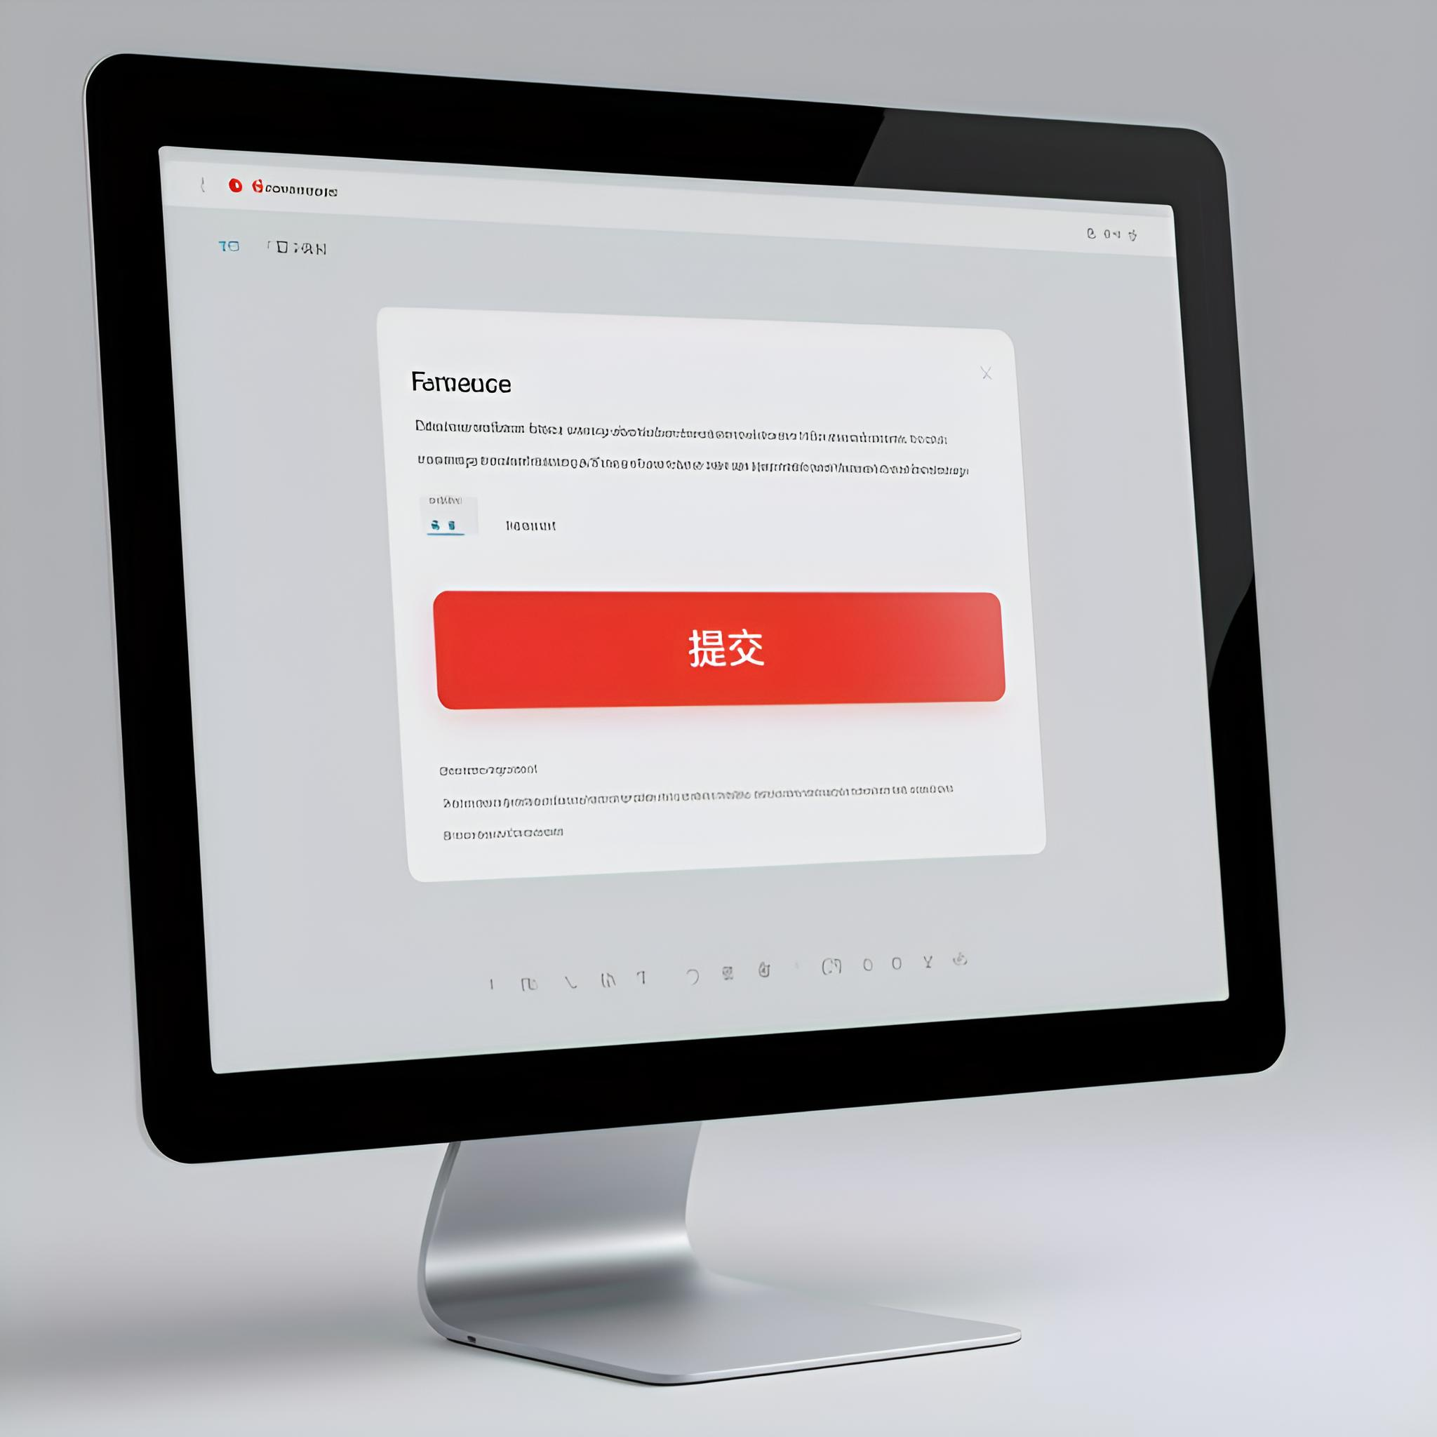
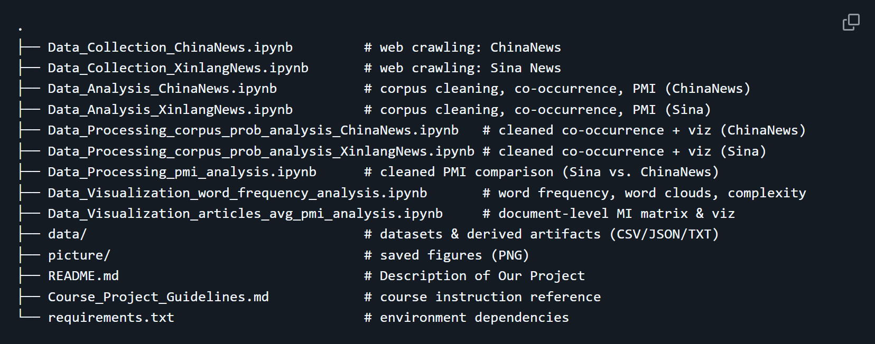
Repository Structure

Slide 20
Environment & Installation
04

Slide 21


Environment & Installation

Slide 22

Dependencies Web scraping: selenium, webdriver-manager, requests, beautifulsoup4, lxml

Slide 23

Processing & analysis: pandas, numpy, jieba

Slide 24
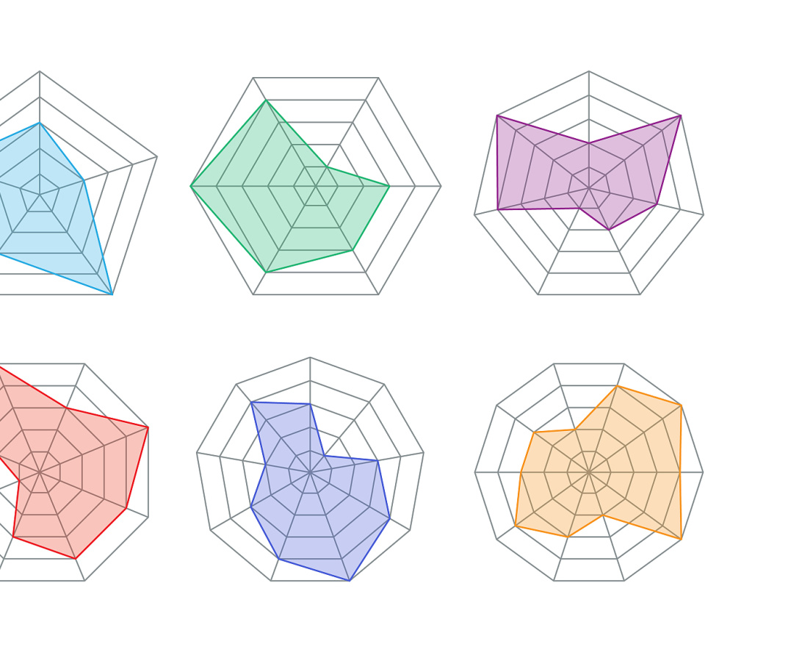
Visualization: matplotlib, seaborn, networkx, wordcloud, Pillow

Slide 25
How to Reproduce (Run Order)
05

Slide 26

How to Reproduce (Run Order)
Run pipeline from scratch or data artifacts
You can run the full pipeline from scratch or start from provided data artifacts

Slide 27
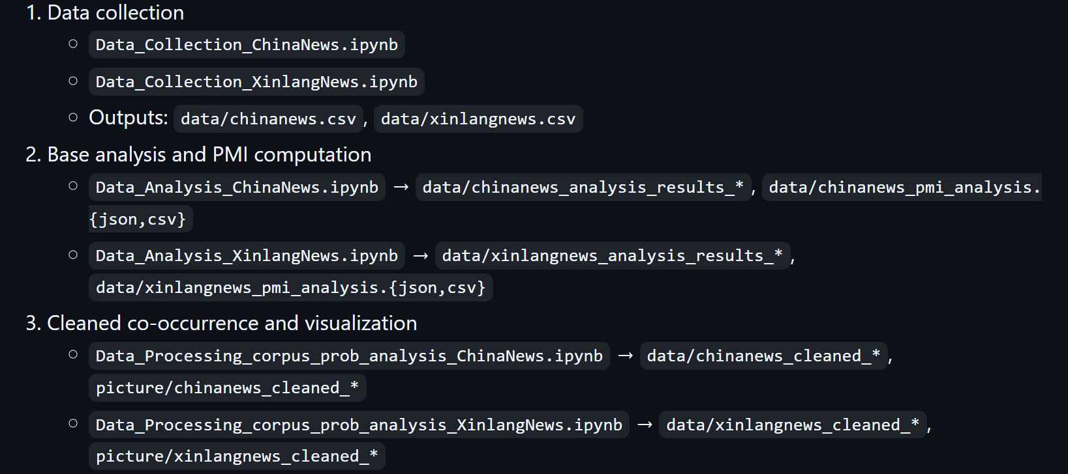
Option A: Full pipeline (from raw collection)：

Slide 28
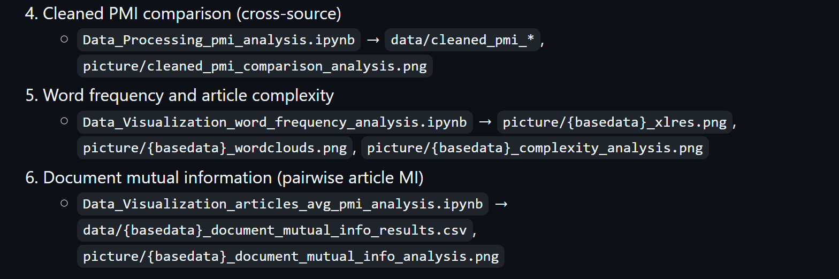
Option A: Full pipeline (from raw collection)：

Slide 29

Option B: Use existing data artifacts
Skip step 1; start from step 2 using data/*.csv and data/*_analysis_results_* already in the repository

Slide 30

Dependencies & Why/How (Key Packages) selenium, webdriver-manager: Headless browser automation for dynamic pages and robust navigation. requests, beautifulsoup4, lxml: HTTP retrieval and structured HTML parsing for content extraction. pandas, numpy: Tabular manipulation, numeric computations, and pipeline-friendly data handling.

Slide 31

jieba: Chinese word segmentation for word-level frequency analysis and complexity metrics. matplotlib, seaborn: Plotting distributions, heatmaps, bar charts, and annotated figures. networkx: Building and rendering directed co-occurrence network graphs. wordcloud, Pillow: Chinese word cloud generation with font support and high-quality image output.
Dependencies & Why/How (Key Packages)

Slide 32
Data Engineering, Cleaning, and Management
06

Slide 33



Cleaning & engineering
How to process text
Strip HTML tags/script/style; remove ads or non-content blocks; normalize whitespace; retain Chinese characters and common punctuation
How compute PMI
Adjacent character co-occurrence counts and conditional probabilities; PMI computed as log2(P(c1,c2)/(P(c1)P(c2))) with P(c1,c2)=P(c2|c1)*P(c1)
Text analysis tasks
Tokenization with jieba for word frequency analysis; word clouds and complexity metrics (lexical richness, average word length)

Slide 34

Management & reproducibility
What is directory structure
Clear directory structure (data/ and picture/) with intermediate and final artifacts saved as CSV/JSON/TXT
Support metadata files reuse
Metadata files and cleaned versions to support inspection and re-use
Reproducible runs file paths
Requirements file and consistent notebook file paths for reproducible runs

Slide 35
Data Analysis: Learning, Analytics, Visualization
07

Slide 36

Data Analysis: Learning, Analytics, Visualization
What is programming project
This is a programming-focused project; we apply code-first techniques to produce interpretable metrics and visualizations. We summarize results by notebook, integrating printed outputs and saved figures

Slide 37

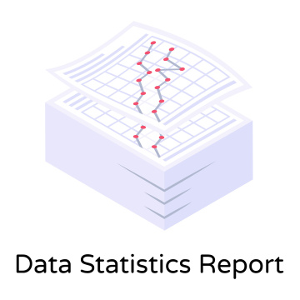
Exploratory Data Analysis：Statistical summaries
ChinaNews
965 articles (df.info()), title/content columns non-null; confirms robust scraping
Sina News
975 articles (df.info()), title/content columns non-null; confirms broad coverage

Slide 38


Corpus statistics
ChinaNews
~3,968 unique Chinese characters; 165,590 adjacent pairs with PMI computed
Sina News
~3,526 unique characters; 181,393 adjacent pairs with PMI computed

Slide 39
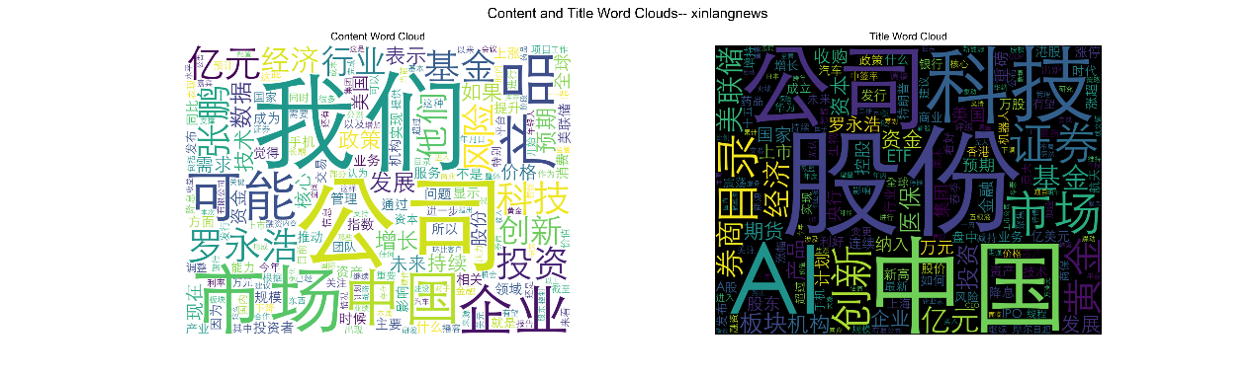
Word frequency:XinlangNews
Top 10 high-frequency words
Top 10 title words
Top 10 high-frequency words in content: 我们、公司、市场、产品、中国、企业、可能、罗永浩、亿元、科技
Top 10 high-frequency words in title: 股份、中国、AI、公司、12、科技、市场、目录、证券、创新

Slide 40
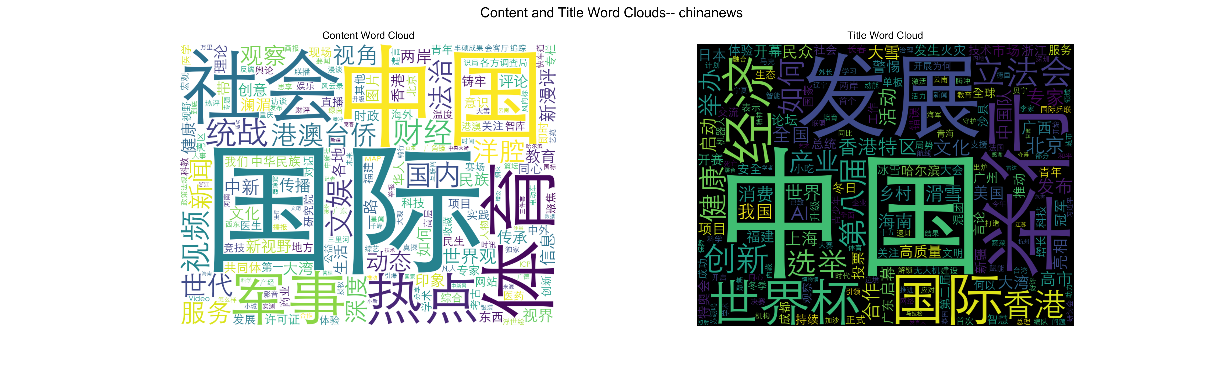
Top 10 high-frequency words in content: 国际、中国、社会、体育、军事、热点、统战、视频、财经、文娱
Word frequency:ChianNews
Top 10 high-frequency words in title: 中国、2025、发展、举行、国际、经济、世界杯、立法会、创新、香港

Slide 41
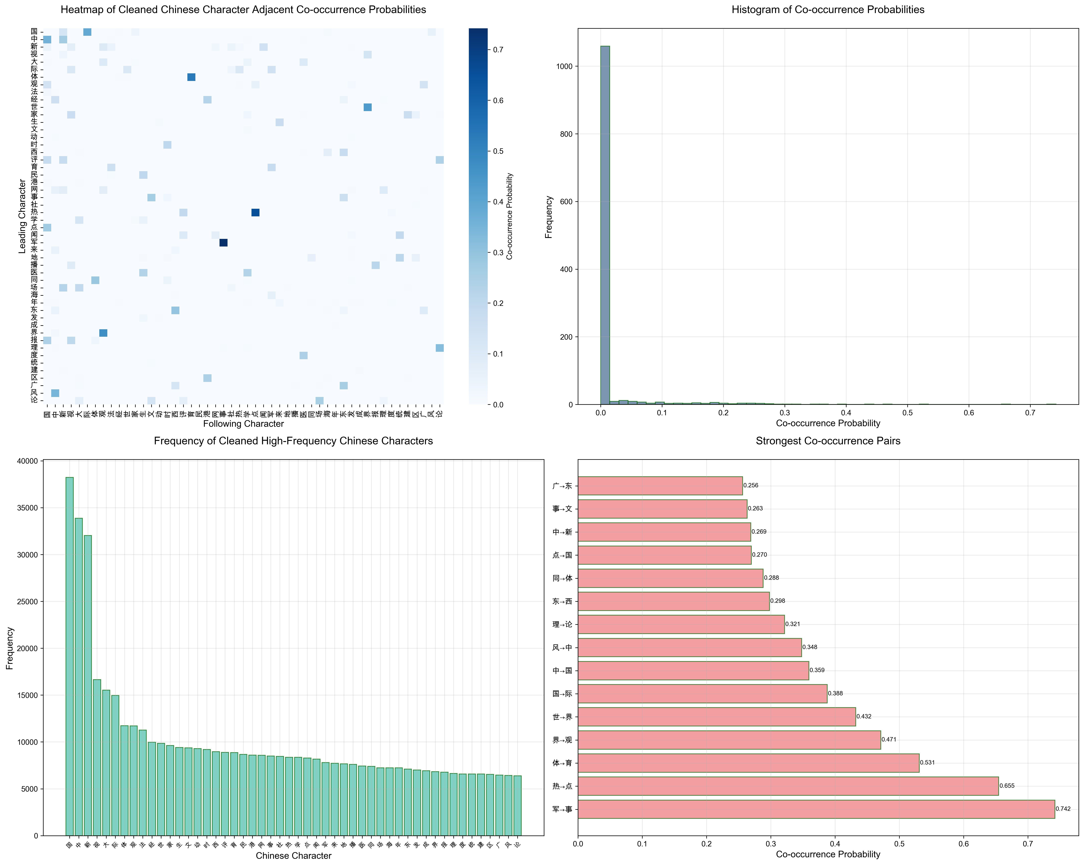
Visualizations: Co-occurrence probability heatmaps (cleaned, top 50 characters):chinanews

Slide 42
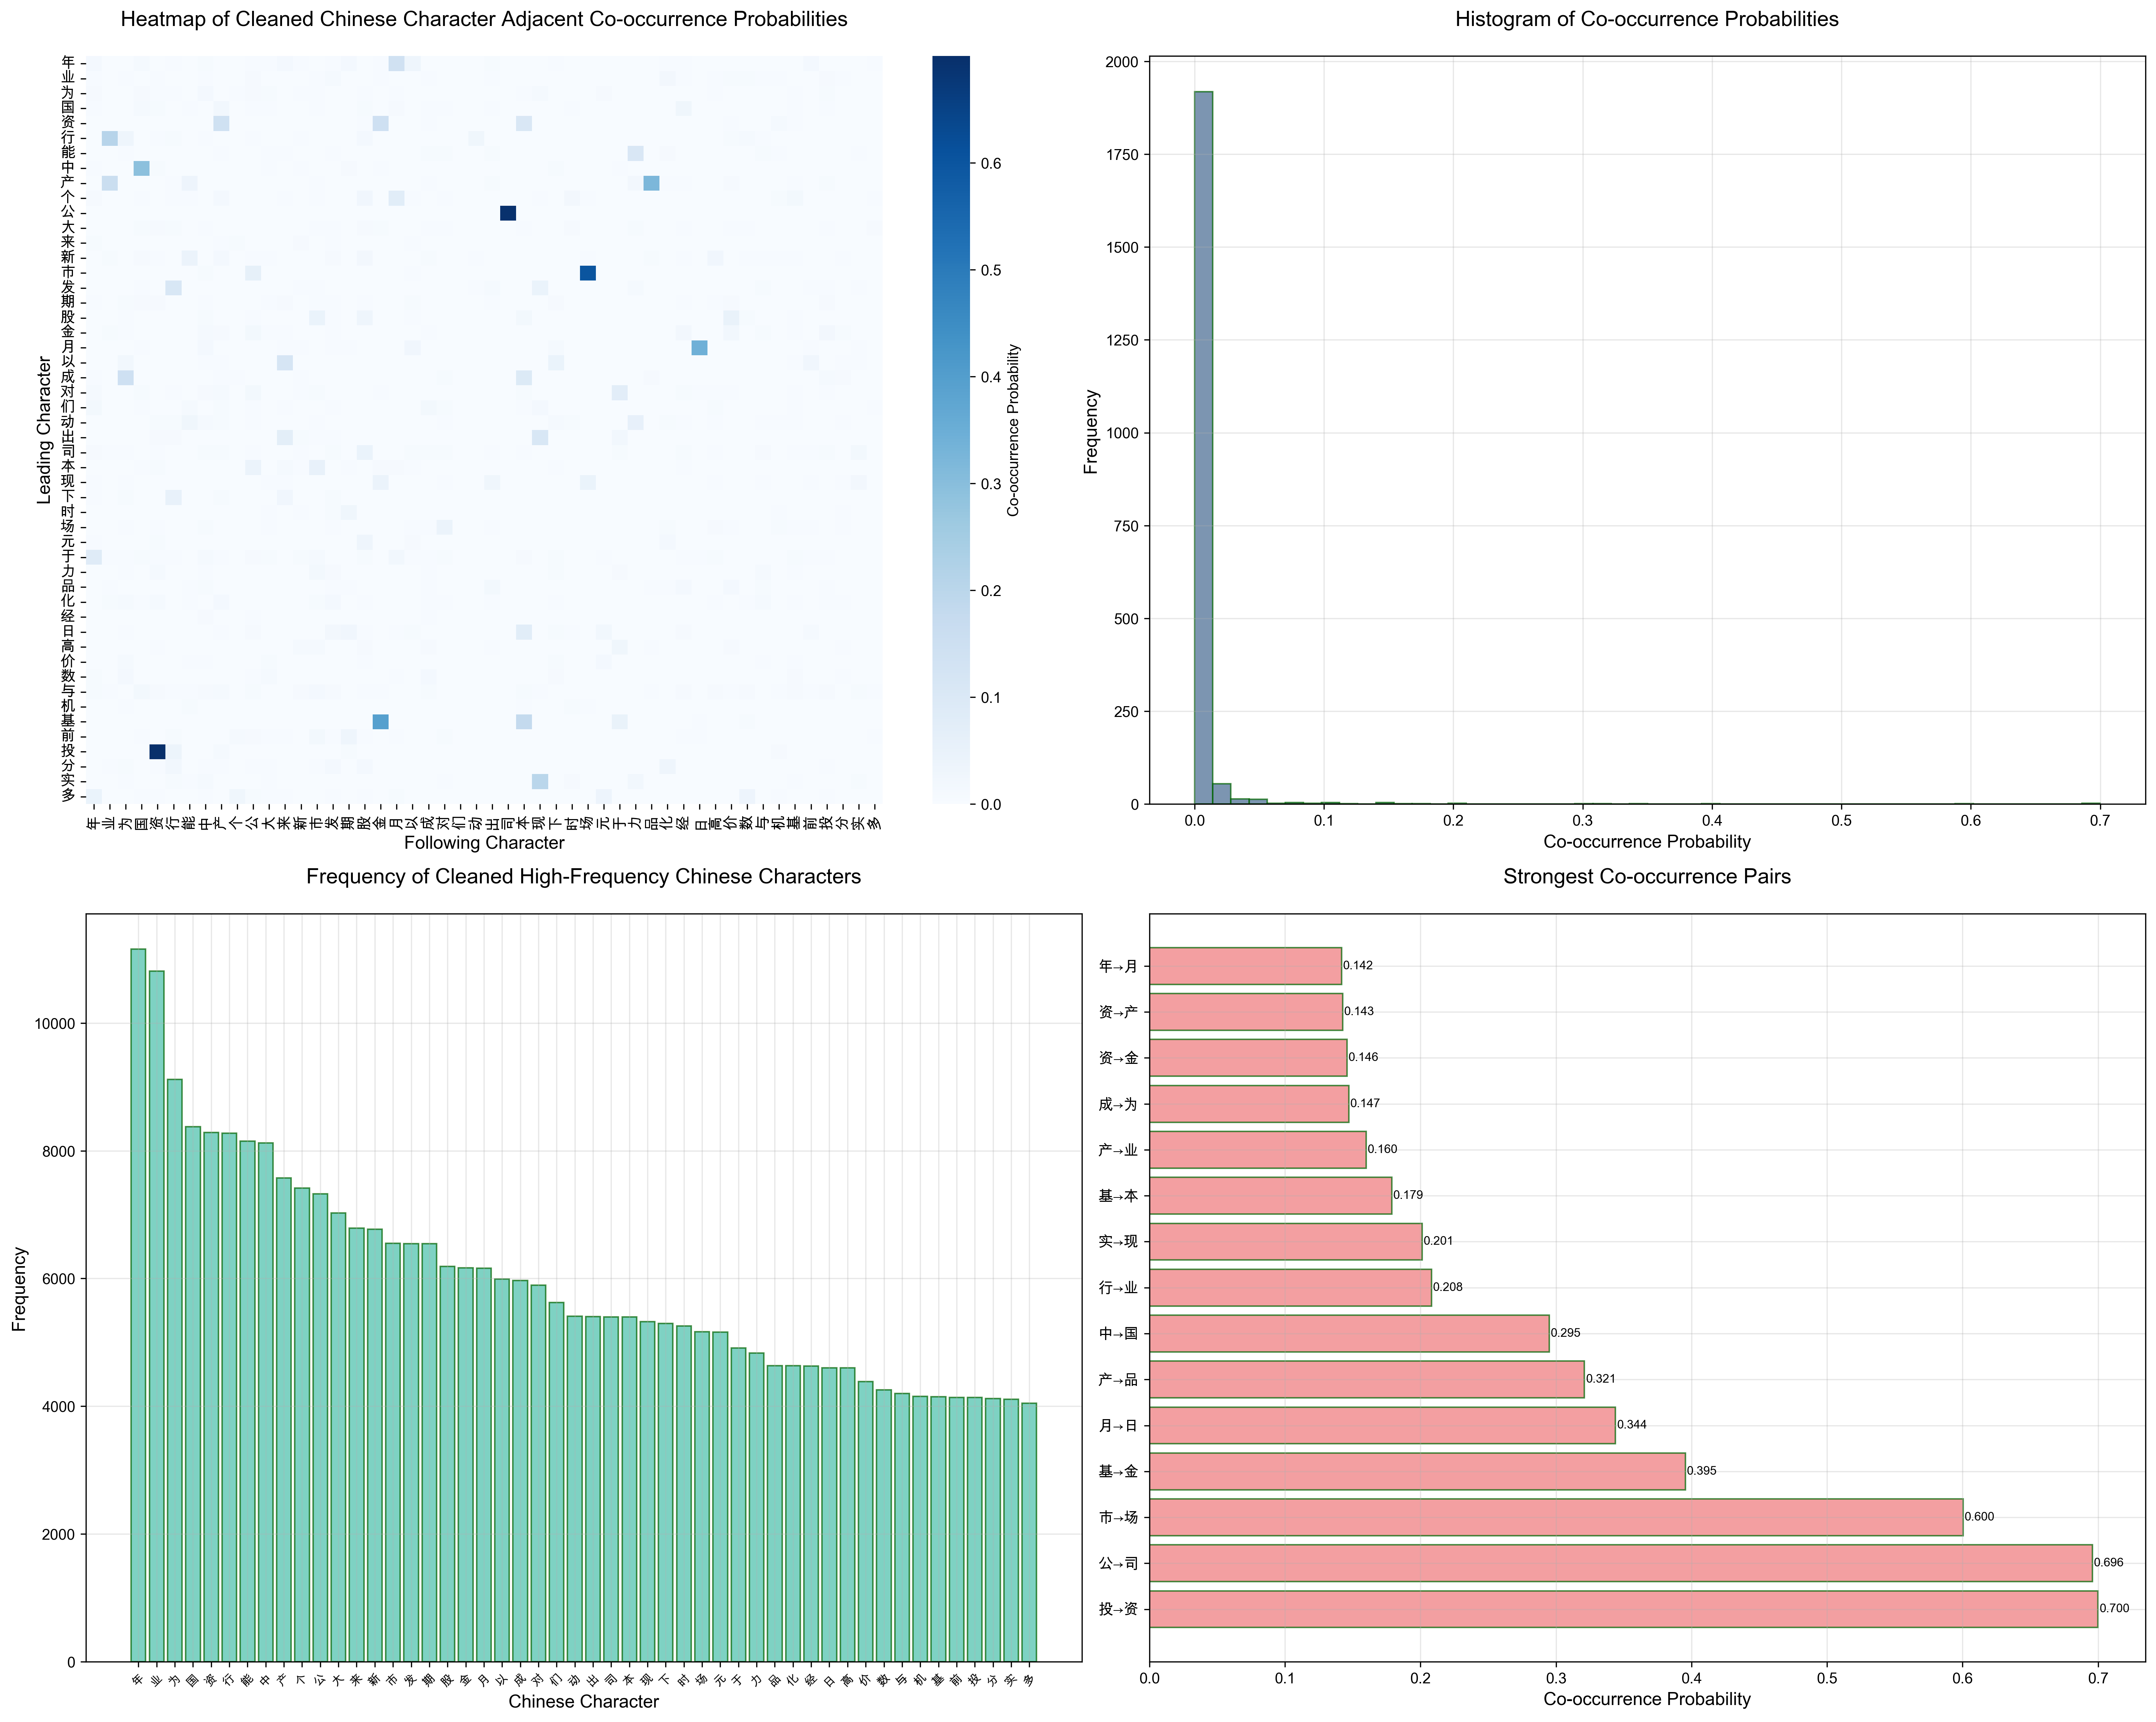
Visualizations: Co-occurrence probability heatmaps (cleaned, top 50 characters):xinlangnews

Slide 43
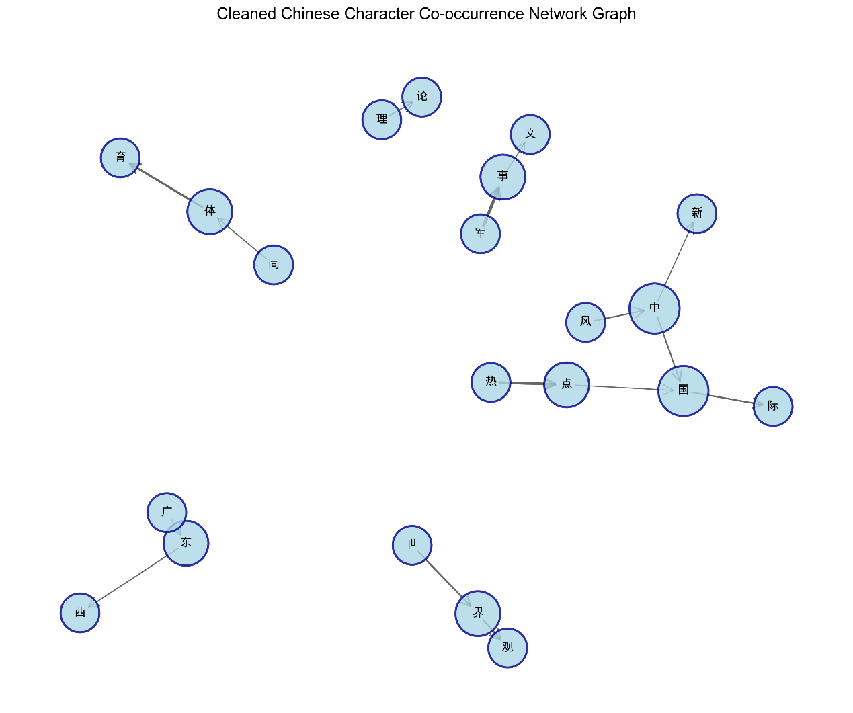
Interpretation highlights
ChinaNews tends to surface national/international themes (强共现：军事/热点/体育/世界/国际等)，reflected by strong adjacent pairs like 军→事 (≈0.7419), 热→点 (≈0.6546), 体→育 (≈0.5310), 世→界 (≈0.4323).

Slide 44
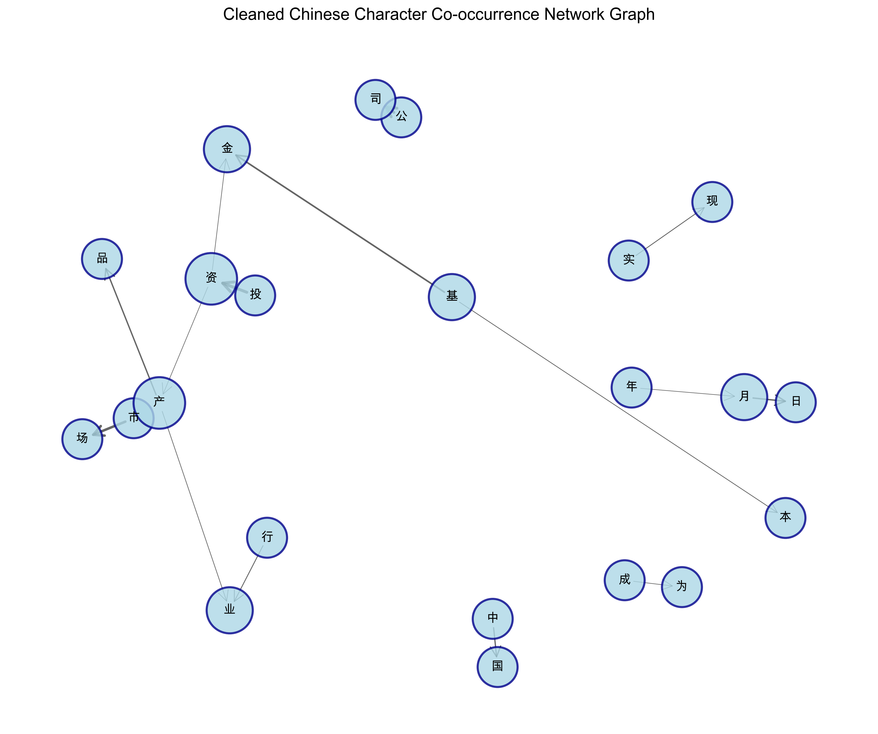
Interpretation highlights
Sina News shows market/economics emphasis (强共现：投→资 (≈0.7000), 公→司 (≈0.6958), 市→场 (≈0.6004), 基→金 (≈0.3955), 月→日 (≈0.3439)).

Slide 45

Modeling & Evaluation
What metrics do we use
We do not pursue complex ML models; instead, we use interpretable metrics

Slide 46
Character-level co-occurrence and PMI
Character-level co-occurrence and PMI:
PMI: PMI(c1,c2) = log2( P(c1,c2) / (P(c1)P(c2)) ) with P(c1,c2)=P(c2|c1)P(c1).
Cleaning of stop words and non-Chinese characters produces more stable PMI distributions and stronger signal in top pairs.
Document-level mutual information:
MI(P,Q) defined via KL divergences to the mean distribution M=0.5*(P+Q); values capped at ln(2).
Valid-doc filtering ensures stable MI estimates; saved top MI pairs with titles aid interpretation.

Slide 47

Evaluation and comparison

Slide 48
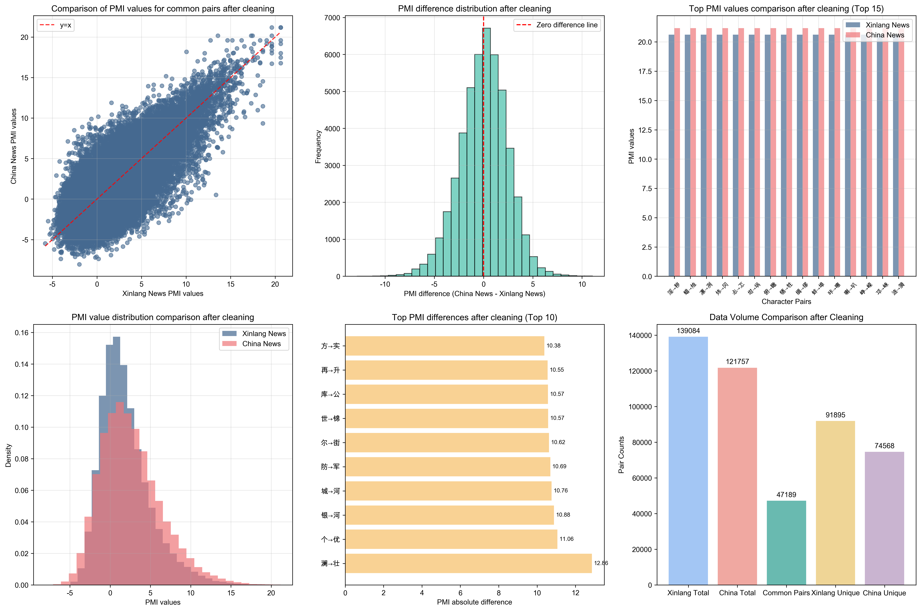
Cleaned PMI comparison (cross-source) uses common vs. unique pairs, difference histograms, scatter against y=x

Slide 49

Common pairs: ~47,189; Xinlang unique: ~91,895; ChinaNews unique: ~74,568.
Mean difference (ChinaNews − Xinlang) ≈ 0.023 over common pairs; top absolute differences highlight outlet-specific phraseology.
Document MI:
Summary statistics printed in the MI notebook (mean, median, min, max, counts) to assess distribution properties and cluster potential.

Slide 50
Visualization & InterpretationVisualization & Interpretation
08

Slide 51

Effective storytelling: Heatmaps communicate structure at scale (co-occurrence probabilities; MI). Histograms reveal distributions and skews (PMI values; MI upper-triangle). Bar charts emphasize top collocations and frequency leaders. Network graphs (cleaned co-occurrence) depict directional relationships with edge weights; node sizes reflect centrality (degree). Word clouds provide intuitive view of topical emphasis across content vs. titles.

Slide 52

Meaningful insights: Fixed expressions and formal journalistic terms dominate top PMI pairs (e.g., 军事、国际、市场、公司、基金等)，indicating stable lexical norms. Source comparisons show ChinaNews’s broader national/international lexical clusters versus Sina News’s market/tech clusters. MI clusters suggest topical groupings suitable for future theme extraction or trend dashboards.

Slide 53
Results & Insights (Comprehensive)
09

Slide 54

ChinaNews vs. Sina News lexical patterns
ChinaNews strong pairs
Sina strong pair examples
Insight
ChinaNews strong-pair examples (probabilities from cleaned matrices): 军→事 ≈ 0.7419, 热→点 ≈ 0.6546, 体→育 ≈ 0.5310, 世→界 ≈ 0.4323, 国→际 ≈ 0.3879, 中→国 ≈ 0.3593
Sina strong-pair examples: 投→资 ≈ 0.7000, 公→司 ≈ 0.6958, 市→场 ≈ 0.6004, 基→金 ≈ 0.3955, 月→日 ≈ 0.3439, 产→品 ≈ 0.3210
outlets exhibit distinct topical collocations aligned with editorial focus—national/international vs. market/tech

Slide 55

PMI distributions
ChinaNews
Sina
Insight
top PMI ≈ 21.18; average ≈ 2.15; median ≈ 1.69; lowest ≈ -9.11
top PMI ≈ 20.62; average ≈ 1.63; median ≈ 1.09; lowest ≈ -8.51
both contain many strong formal collocations; ChinaNews shows slightly higher average PMI after cleaning

Slide 56
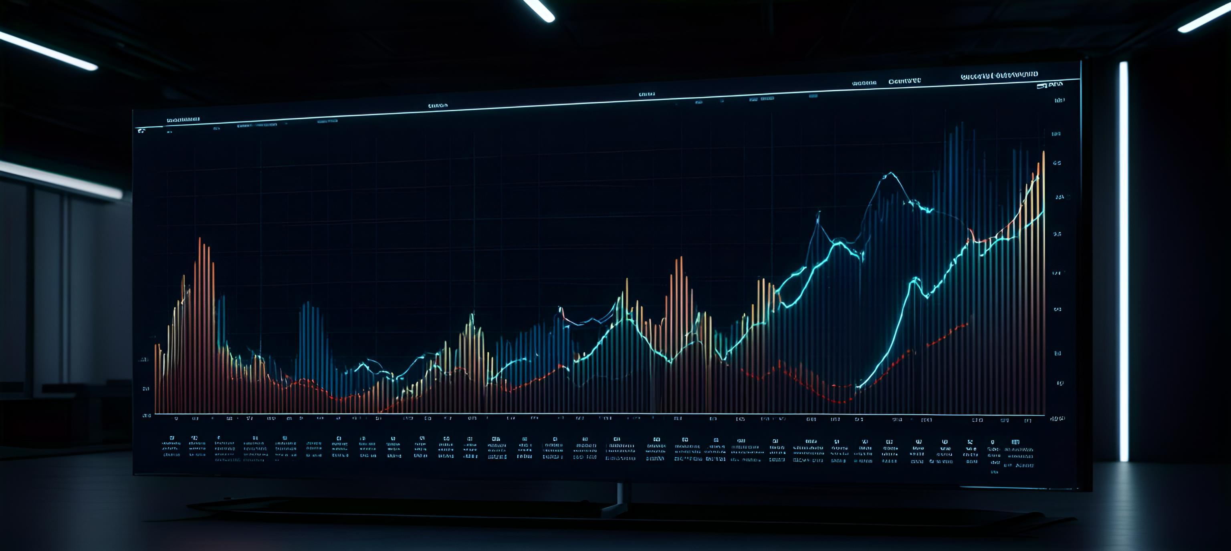

Cross-source cleaned PMI comparison
ChinaNews PMI strength
Inspect outlet phraseology
Common pairs ~47k; small positive mean difference (≈0.023) suggests ChinaNews marginally stronger PMI on average for shared pairs
Top abs-diff pairs reveal outlet-specific phraseology to inspect (visuals and CSV saved for detailed review)

Slide 57
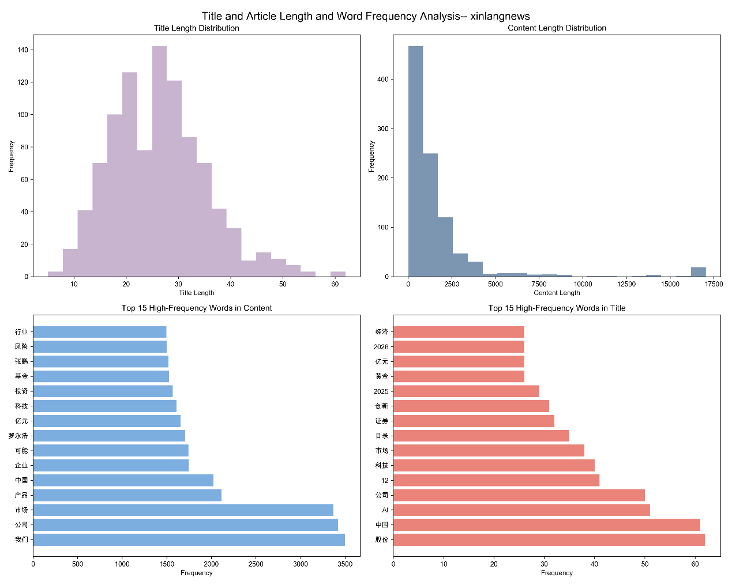
Word frequency & complexity (xinlangnews example)
ChinaNews: frequent strong pairs reflect broad news topicality (军事/热点/体育/世界/国际). High-PMI pairs include formal fixed expressions and journalistic terms, suggesting tighter collocational patterns.
Sina News: strong economic/market collocations (投资/公司/市场/基金/月日) and tech themes (AI、科技、证券). Word frequency analysis corroborates the topical lean.
Complexity histograms: lexical richness and average word length distributions indicate stylistic variability across articles.

Slide 58
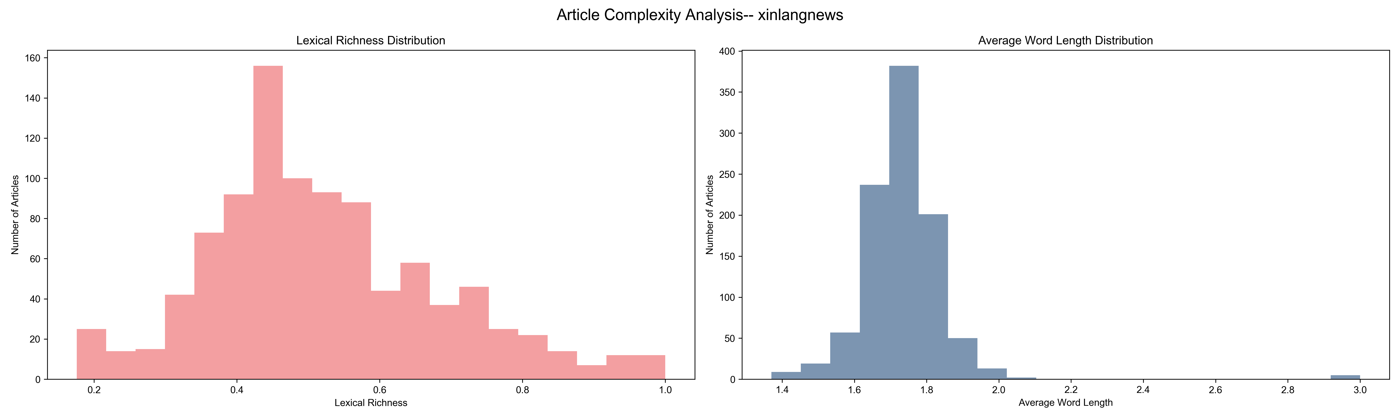

Slide 59
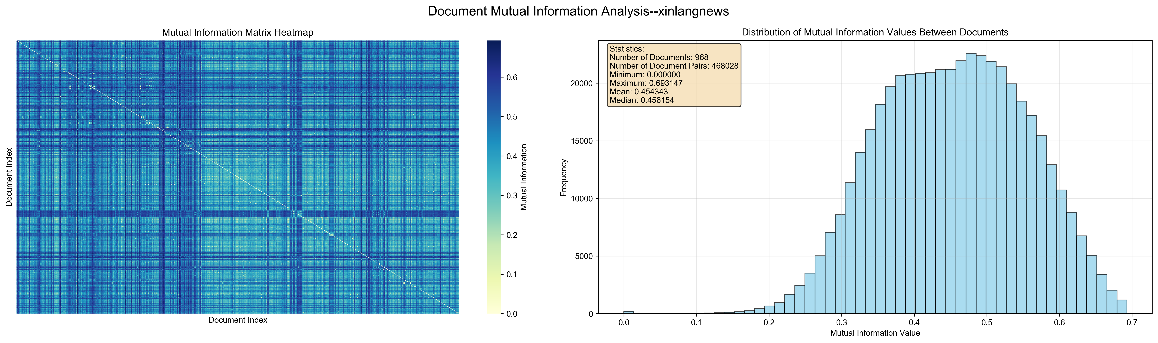
Document mutual information: Vocabulary size ~3.4k; valid documents ~968 (xinlangnews); MI range [0, 0.693147]; average ~0.454; median ~0.456. Insight: Many article pairs exhibit moderate-to-high similarity, reflecting common themes; top MI pairs (titles printed) indicate highly aligned content.

Slide 60
Conclusion & Reflection
10

Slide 61


Key findings
A fully reproducible, interpretable pipeline transforms raw web news into transparent metrics and rich visuals
Clear collocational structures emerge in both sources; top PMI pairs are fixed expressions or formal terms typical of Chinese news
Cross-source contrasts (ChinaNews vs. Sina) reflect editorial focus—national/international vs. market/tech—supported by co-occurrence, PMI, and frequency analyses
Document MI reveals clusters of similar articles, suggesting topical grouping potential

Slide 62
Limitations
PMI limitations and issues
01
Adjacent-character PMI misses longer multi-character phrases or named entities; segmentation quality affects word-level stats
How handle web scraping issues
02
Web layout changes can disrupt scraping; anti-bot measures necessitate careful throttling and retries
Topic context modeling
03
Topic context is partially captured at character level; sentence/paragraph structure not explicitly modeled

Slide 63
Reflection (team learning)
01
02
Why improve workflow
How visual storytelling helps
Building an end-to-end, code-driven workflow improves reproducibility and interpretability; cleaning decisions materially affect downstream metrics
Visual storytelling (heatmaps, network graphs, word clouds) helps communicate complex structures effectively

Slide 64




Future work
Collocation analysis methods
Analyze time trend and topics
Phrase-level PMI (n-grams) and named-entity-aware collocation analysis
Time-resolved trend analysis (daily/weekly windows) and topic clustering with interpretable features
Dashboard and sentiment analytics
What are robust scraping features
Cross-outlet dashboards and more nuanced sentiment/stylistic analytics
Robust scraping orchestration (retry logic, error logs), environment freezing (lockfile), and automated figure generation pipelines

Slide 65
References
11

Slide 66






Tools and Libraries
NewsSpider (reference project)
jieba: Chinese text segmentation
BeautifulSoup
NetworkX
WordCloud for Python
Matplotlib / Seaborn

Slide 67

Articles, Guides, and Papers
Articles, Guides, and Papers
知乎专栏：中文文本分析入门与方法概览
GWU Text Analysis Methods Guide
CMCL 2022: A Corpus-based Analysis of Lexical Co-occurrence and Predictability
Pointwise Mutual Information and Information Retrieval (Scientific Methods, 1996)

Slide 68
Acknowledgements
12

Slide 69

Acknowledgements
This project adheres to the CISC7201 Data Science Programming Course Project Guidelines and uses self-collected datasets only, focusing on programming, reproducibility, and clear communication of insights

Slide 70
THANKS
THE END

